Slide 1
Machine Ready:
Windows
Overview In this assignment, you will be installing all of the required tools and software necessary for the class. We've got a lot to install, so buckle in and get ready!
Before You Begin Make sure you sign up for these services; you'll need all of them throughout the course:
LinkedIn: https://www.linkedin.com
GitHub: https://github.com
StackOverflow: http://stackoverflow.com
Don't just create logins. Job recruiters often scour these sites in search of job candidates; make sure you provide your headshot and your contact info on all three services. P.S. Don’t forget to outline your skills and your work experience on LinkedIn. You will receive the link to your class-specific Slack channel during orientation - make sure to accept the invite in order to communicate with your class and instructional team.

Slide 2
Da Big Installation Enchilada
The rest of this assignment will walk you through the specific steps associated with installing each of the tools you'll need. Follow the instructions closely.

Slide 3
Google Chrome
During this course, consider Chrome the web browser; it comes loaded with tools for quickly editing the web pages you’ll create.
1. If you don’t already have Chrome installed, visit their download page.
2. Download, open, and run through Chrome’s installation file.

Slide 4
Screencastify
There are two places where you can install the Screencastify extension:
1. The Screencastify Website.
2. The Chrome Web Store.
Note: You must be using Google Chrome to install and use Screencastify
Install Screencastify from their Website:
Go to the homepage and click the blue "Free 1-Click Install" button. You'll see a confirmation box confirming that you want to install the extension. Click "Add extension". Screencastify will then begin downloading.
Install Screencastify from the Chrome Web Store:
Click here to view their listing in the Chrome Web Store, then click "Add to Chrome". You'll see a confirmation box confirming that you want to install the extension. Click "Add extension". Screencastify will then begin downloading.

Slide 5
Slack
You’ll be messaging your instructor, your TAs, and your fellow classmates with this businesscentric chatting app.
The teaching and career staff will post some of their most important announcements here so set this program up as soon as you can.
You will receive the link to your class-specific channel during orientation.
If you don’t have the Slack app yet, go to Slack. Select "Windows" to download the installation file, and then open the program.

Slide 6
Joining the Slack Workspace
If you already use the Slack app, you just need to add our channel to your application. Using the invitation that you receive during orientation, use the following instructions to add the channel:
Click the plus symbol on the side of your Slack window.
Then select “Sign in to another workspace”
Enter in the domain we gave you for Slack.
Enter in the email with which we invited you, as well as your password, when prompted.
When you see the chatroom, you’re finished.

Slide 7
Visual Studio Code
This text editor features a variety of indispensable tools and customizable components that will help you code your websites and apps.
Download the appropriate version for your operating system here.
Once the download is complete, open and run the installer file.
Go through the prompts presented in the installer. When you reach the following screen, select the following settings.
Once the installation is complete, you should be able to access Visual Studio Code from your start menu.

Slide 8
Install "Open in Default Browser" Extension
With this extension, you can open HTML files in your web browser from the Visual Studio Code editor.
1. Open Visual Studio Code.
2. Open the extensions pane and search for "Open in Default Browser".
3. Select the version written by "peakchen90" and install.

Slide 9
Git & Git Bash
Coders depend on this tool for version control; the process of logging the development of programs and applications.
This comes in handy during collaborative programming, when teams of programmers change, add, and remove code throughout a project’s directory; this process would be chaotic without Git.
The installation also includes Git Bash, or Bash for short. You'll be using this command line terminal throughout the course and during the rest of these instructions.
Go to Git download page: here. Click on the download for your computer.
Run through the installation file. Make sure you check off the right boxes as shown in the images in the following slides.

Slide 10
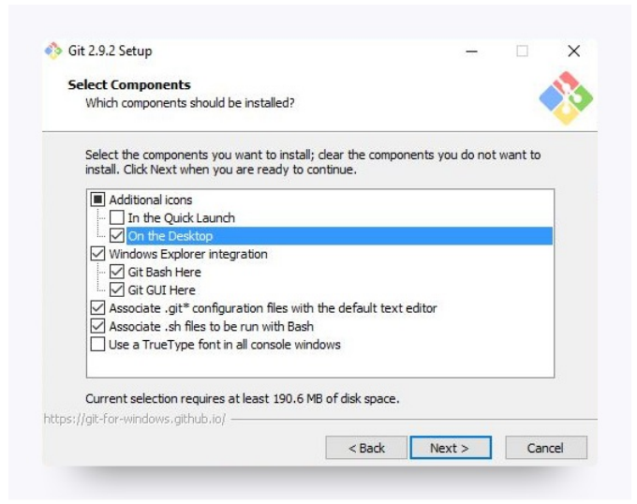
Installing Git

Slide 11
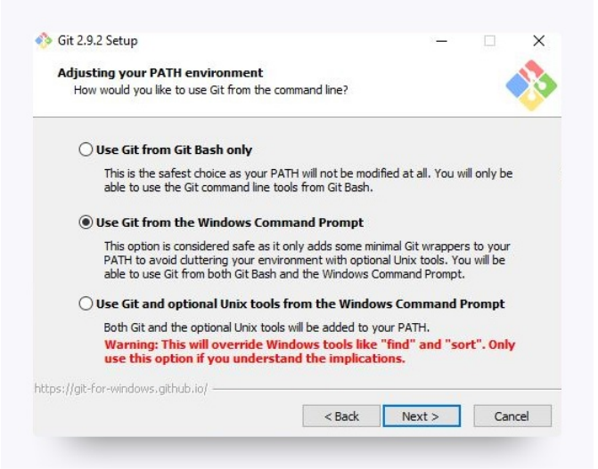
Installing Git

Slide 12
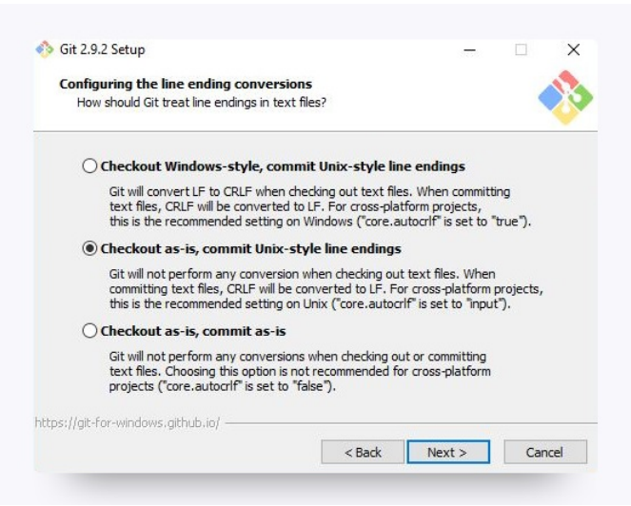
Installing Git

Slide 13
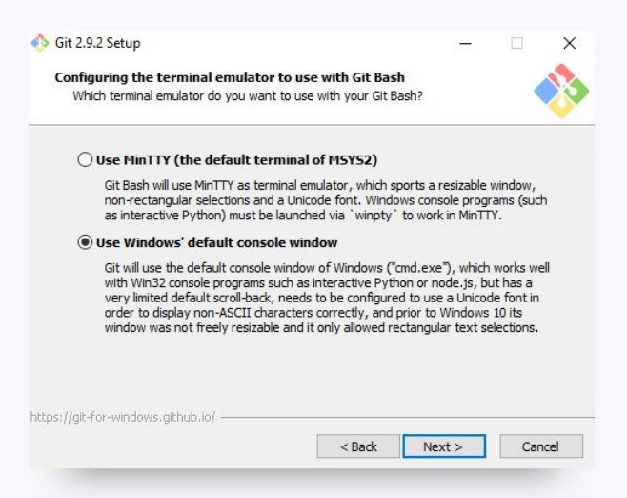
Installing Git

Slide 14
Node.js
This runtime environment has quickly become the standard for coding back-end programs. Your code will run on Node throughout most of the course.
Go to the Node.js site: here. Click the download button for the LTS (Recommended for Most Users) and run through the installation file.

Slide 15
Setting your Git username for every repository on your computer
Git uses a username to associate commits with an identity. The Git username is not the same as your GitHub username.
You can change the name that is associated with your Git commits using the git config command. The new name you set will be visible in any future commits you push to GitHub from the command line.
If you'd like to keep your real name private, you can use any text as your Git username. Changing the name associated with your Git commits using git config will only affect future commits and will not change the name used for past commits.

Slide 16
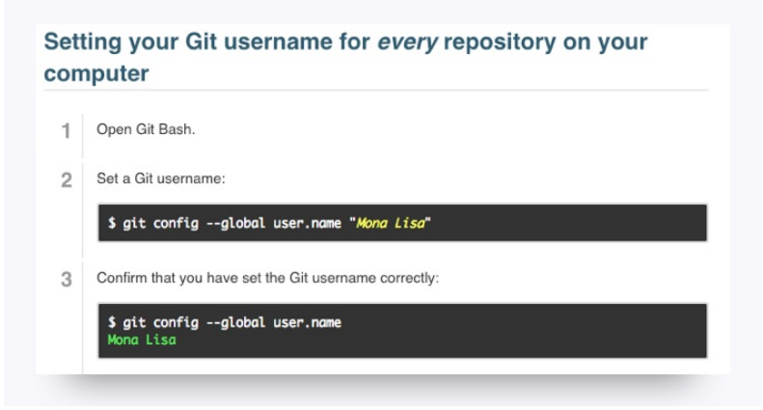
Git Config Username

Slide 17
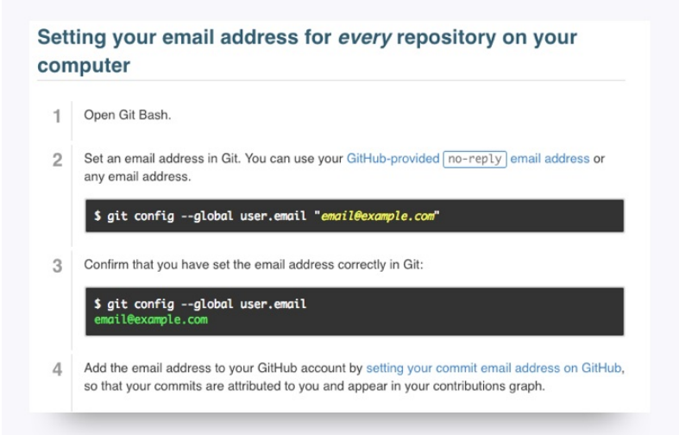
Git Config Email

